Slide 1
Derby air pollution analysis
Analysed by Alex Large (Junior Data Analyst) as a furlough project
Sharing graphs on Instagram at @derbyairpollution
My email: alexanderklarge@gmail.com
Analysed with Python coding language
Code visible here: https://github.com/productivityboyz/Air-Pollution-Project (main file = Alex’s Air Pollution Analysis.ipynb)
Notes:
1) My name & job
2) Reason for doing project – XR and data
3) Sharing project to Instagram and the code can be seen on GitHub

Slide 2
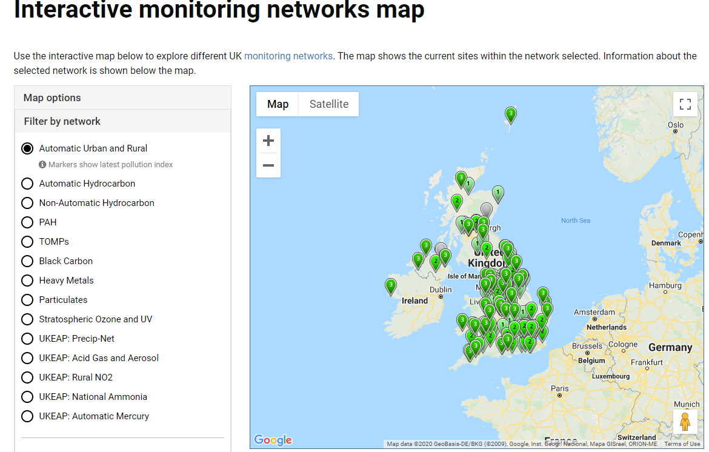
https://uk-air.defra.gov.uk/interactive-map - url for map
https://uk-air.defra.gov.uk/networks/network-info?view=aurn – info on the AURN
Notes:
Logistics: DEFRA air quality network CALLED “Automatic Urban and Rural Network (AURN)
Measuring NO and NO2 – other cities also include PM2.5s, methane etc
Code is built in a way to make analysis of other cities quick and easy (and a friend is looking at Reading)

Slide 3
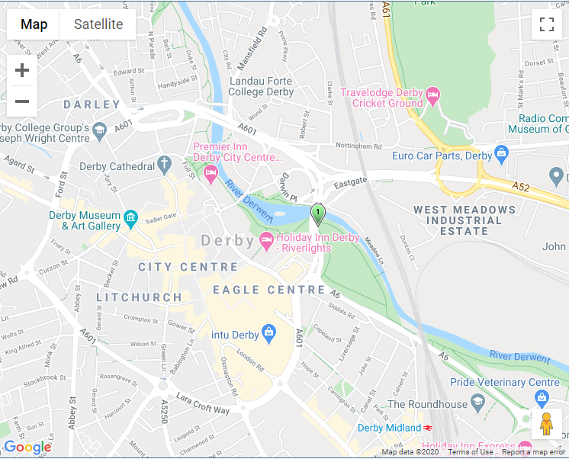
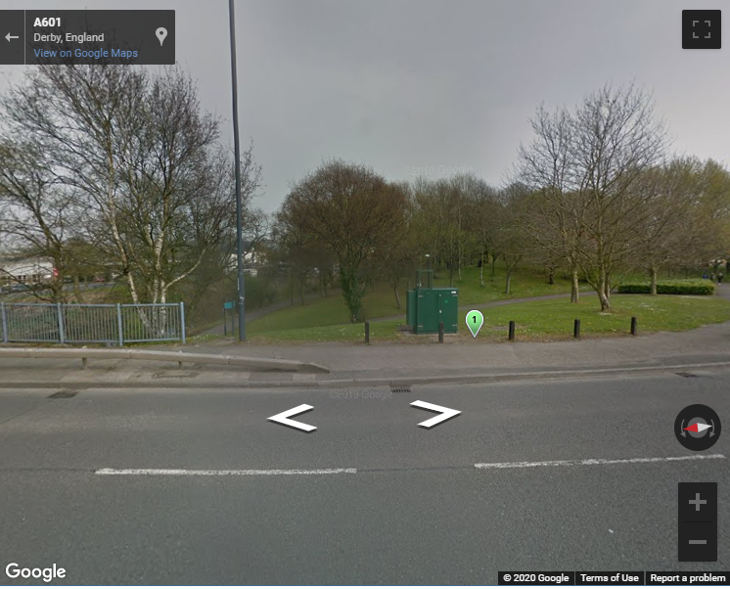
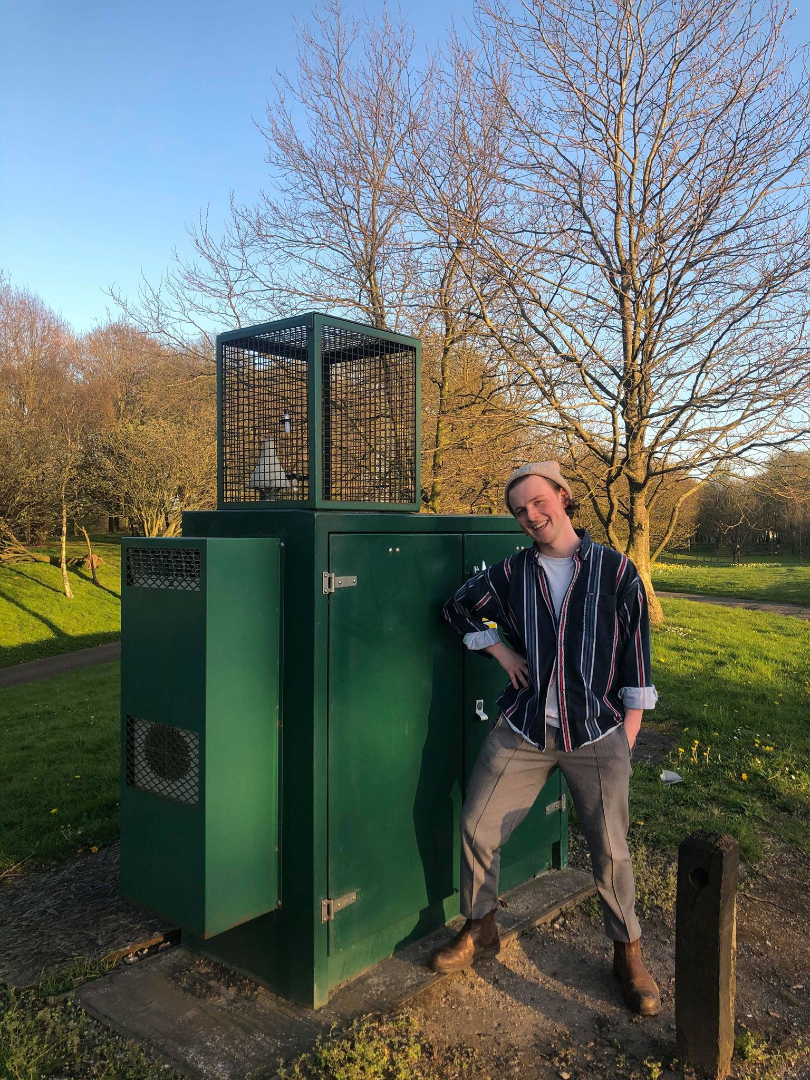
Notes:
Derby’s sole sensor
Have to remind myself that it’s not Derby’s air pollution, it’s the pollution measured at this one spot
The sensor takes an hourly measurement and has been since the 22nd of January 2017

Slide 4
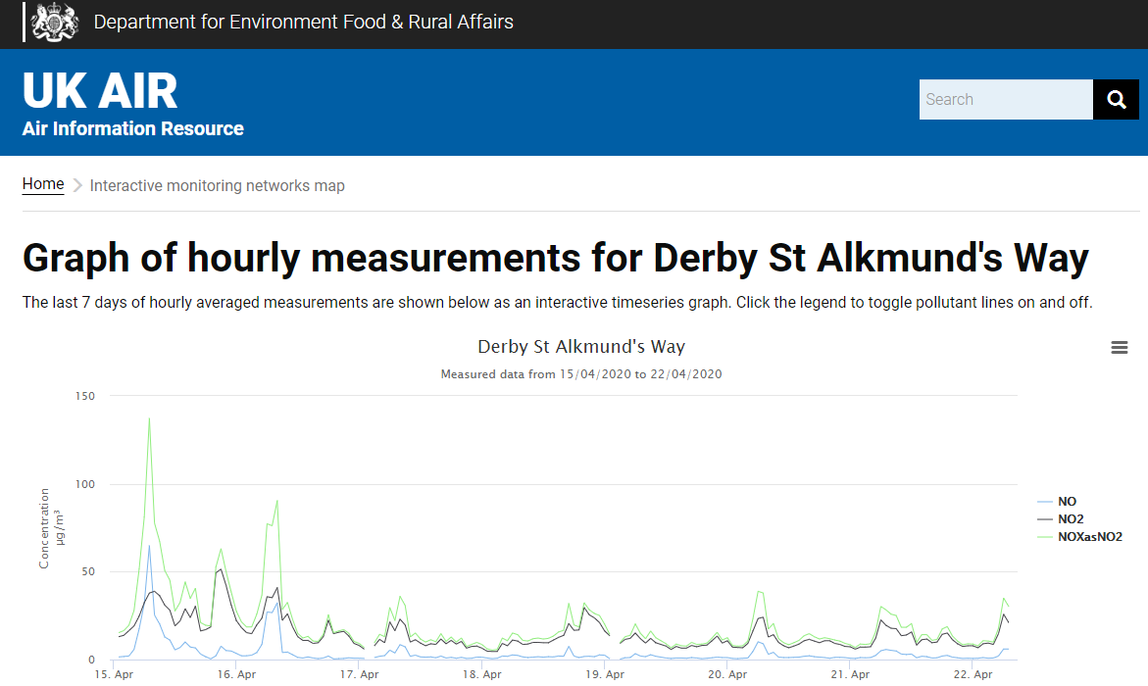
Notes:
This is all you can get from the DEFRA site
Not very useful as only 7 days.
No date selector!

Slide 5
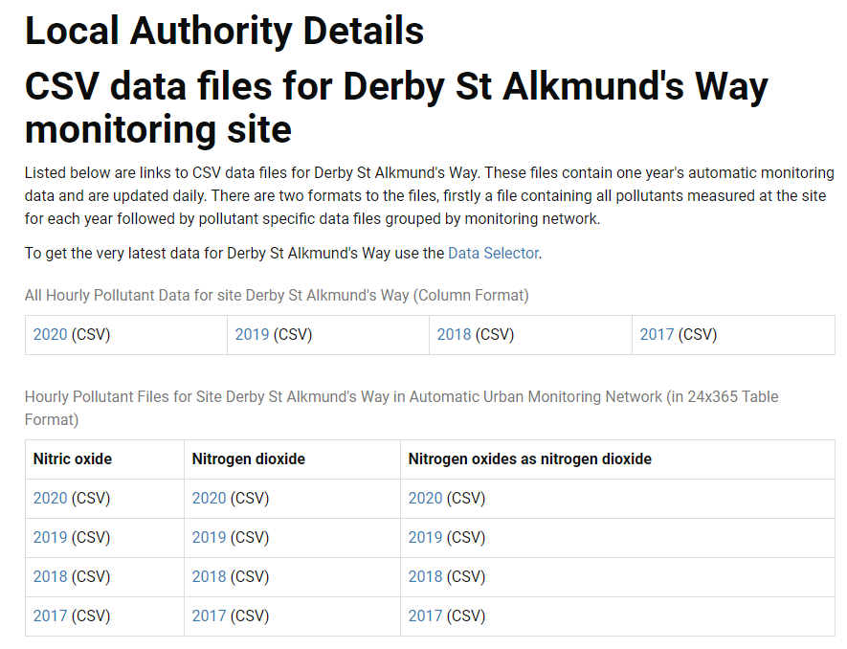
Notes:
1) The data download

Slide 6
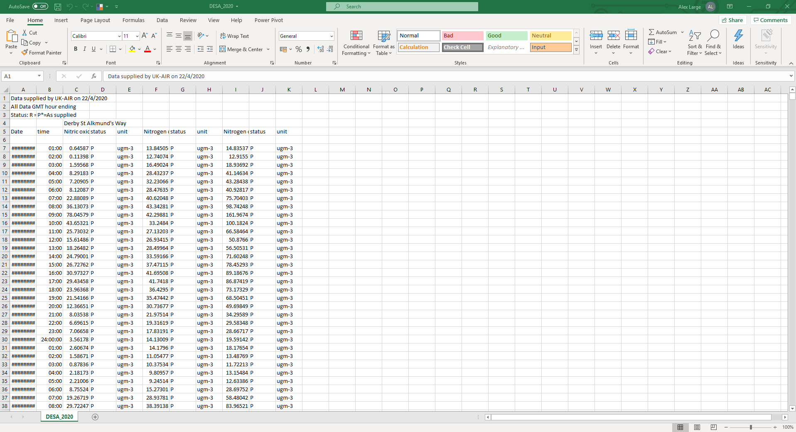
Notes:
What the data looks like
Instead of Excel, you can use Python and get it to download the refreshed dataset every time you run the script
Instead of downloading every day

Slide 7
Quick Analysis of Whole Dataset

Slide 8
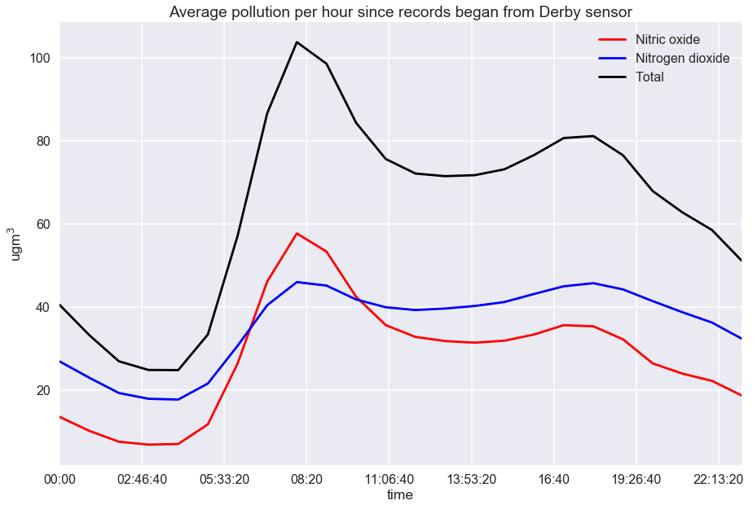
Average pollution over a day
Notes:
Just some quick exploration of the whole dataset
Bimodal

Slide 9
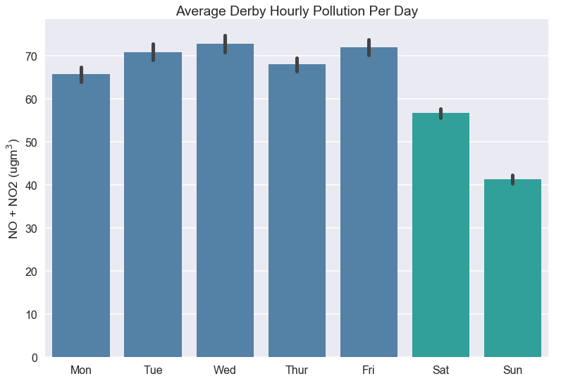
Average pollution across weekdays

Slide 10
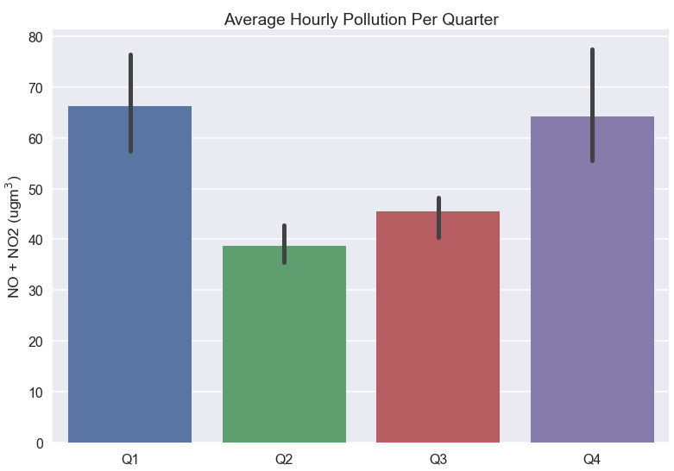
Pollution across quarters

Slide 11
2020 weekly pollution vs previous years

Slide 12
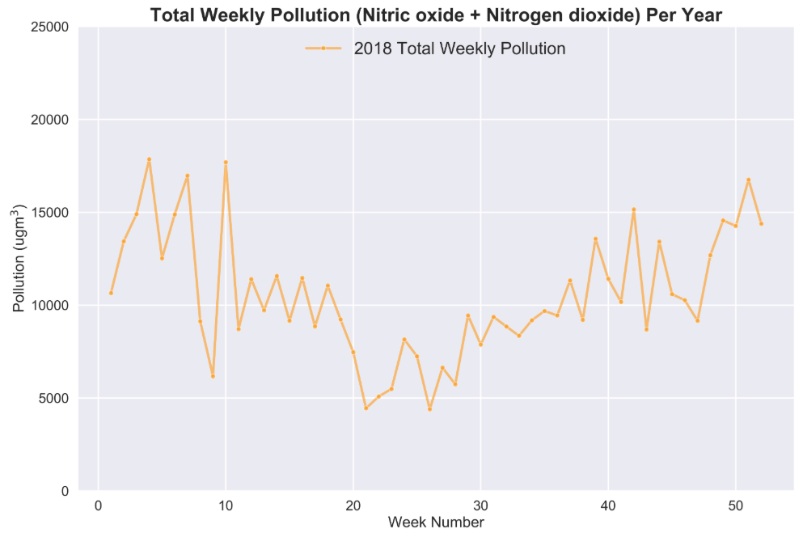

Slide 13
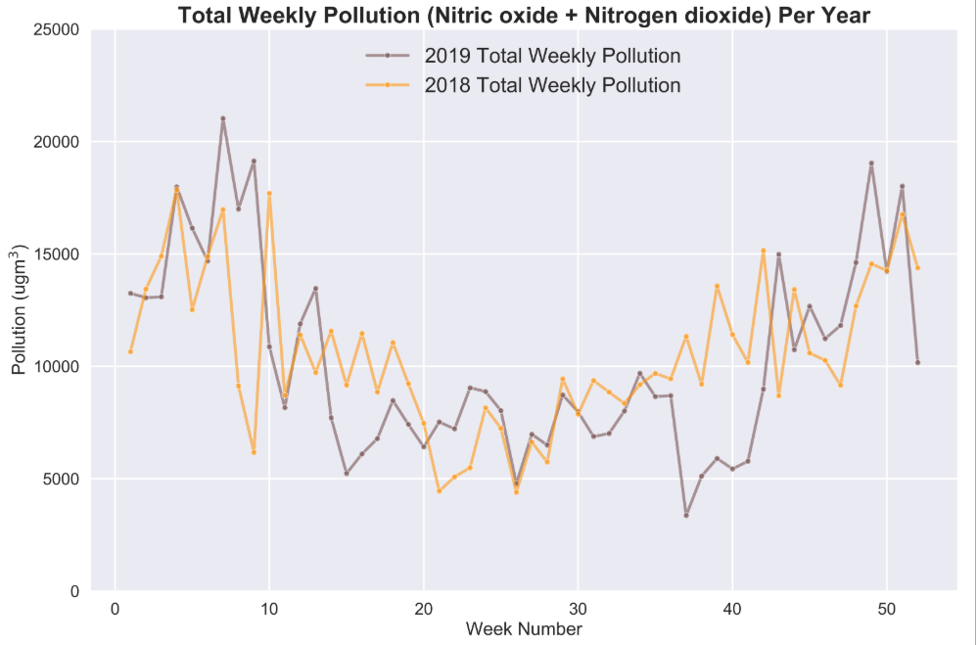

Slide 14
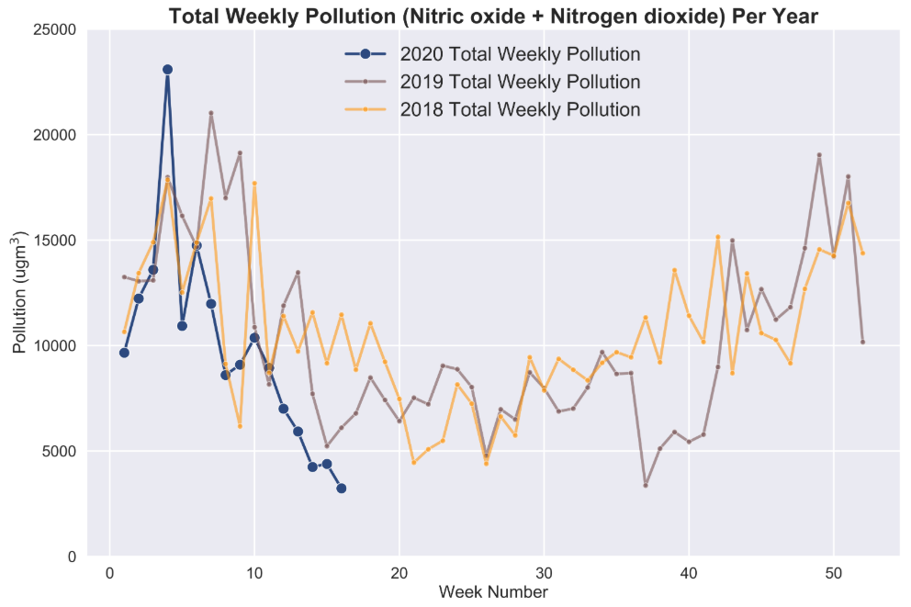

Slide 15
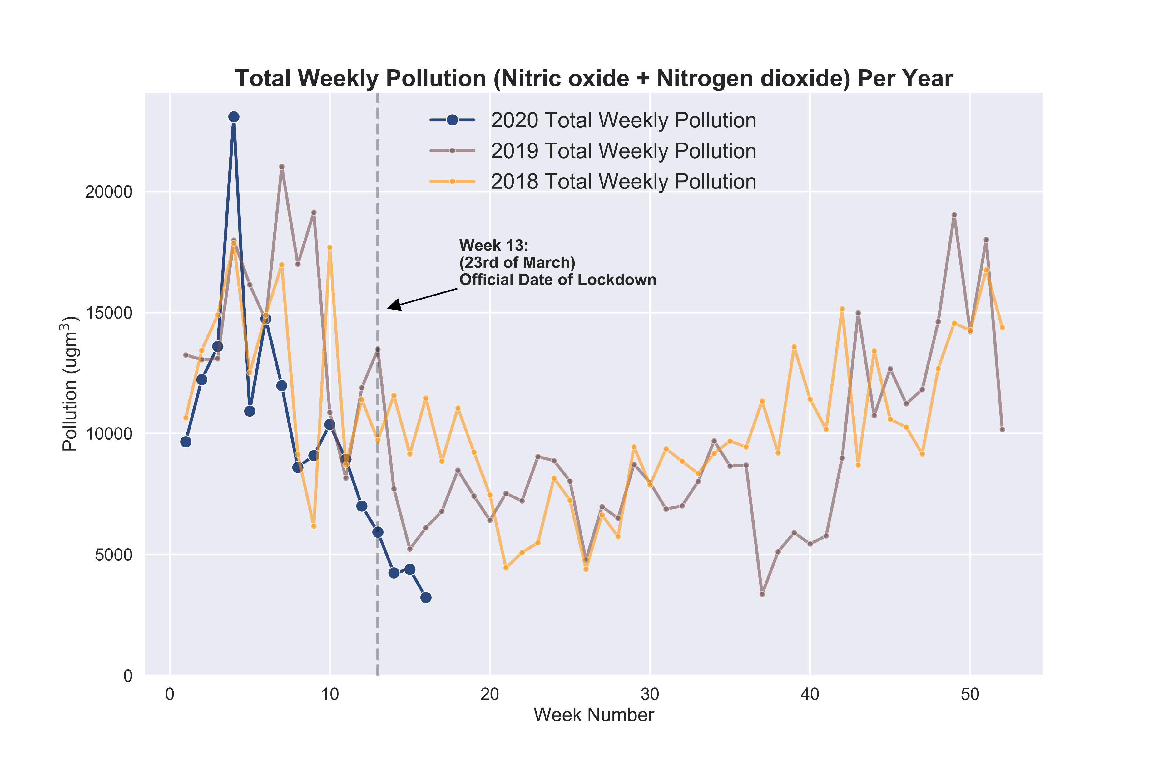
2020 compared to 2019 and 2018
Notes:
Commentary: note that pollution is clearly high in Q1 and Q4 and drops in Q2 and Q3

Slide 16
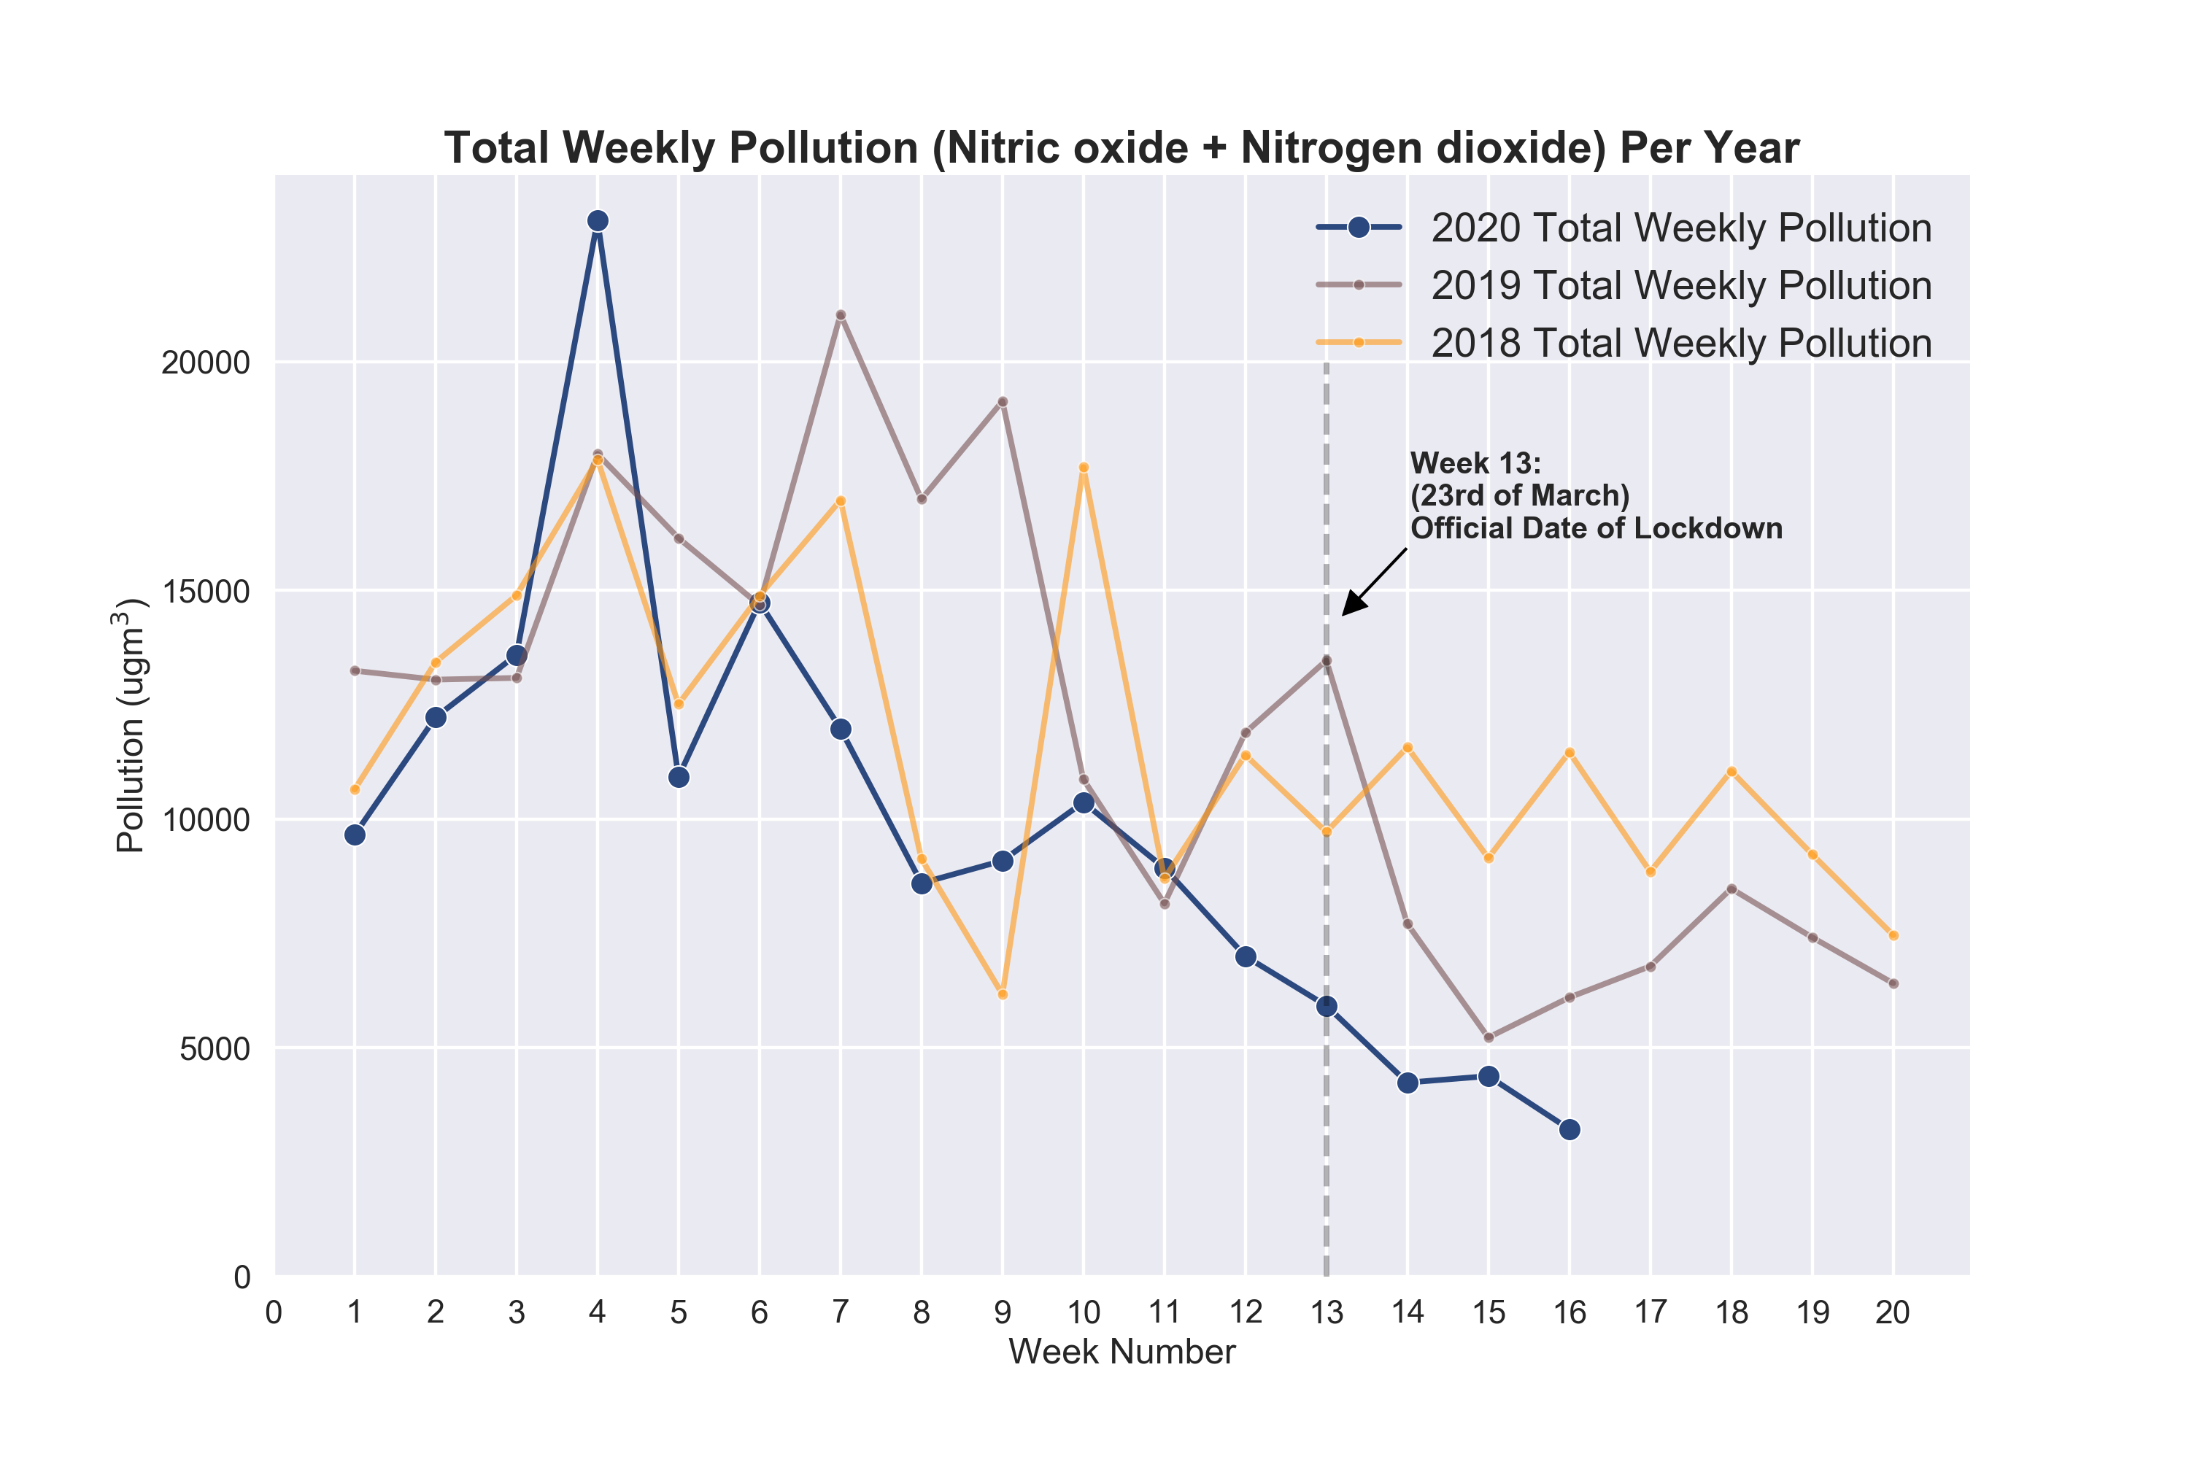
Previous graph but zoomed in

Slide 17
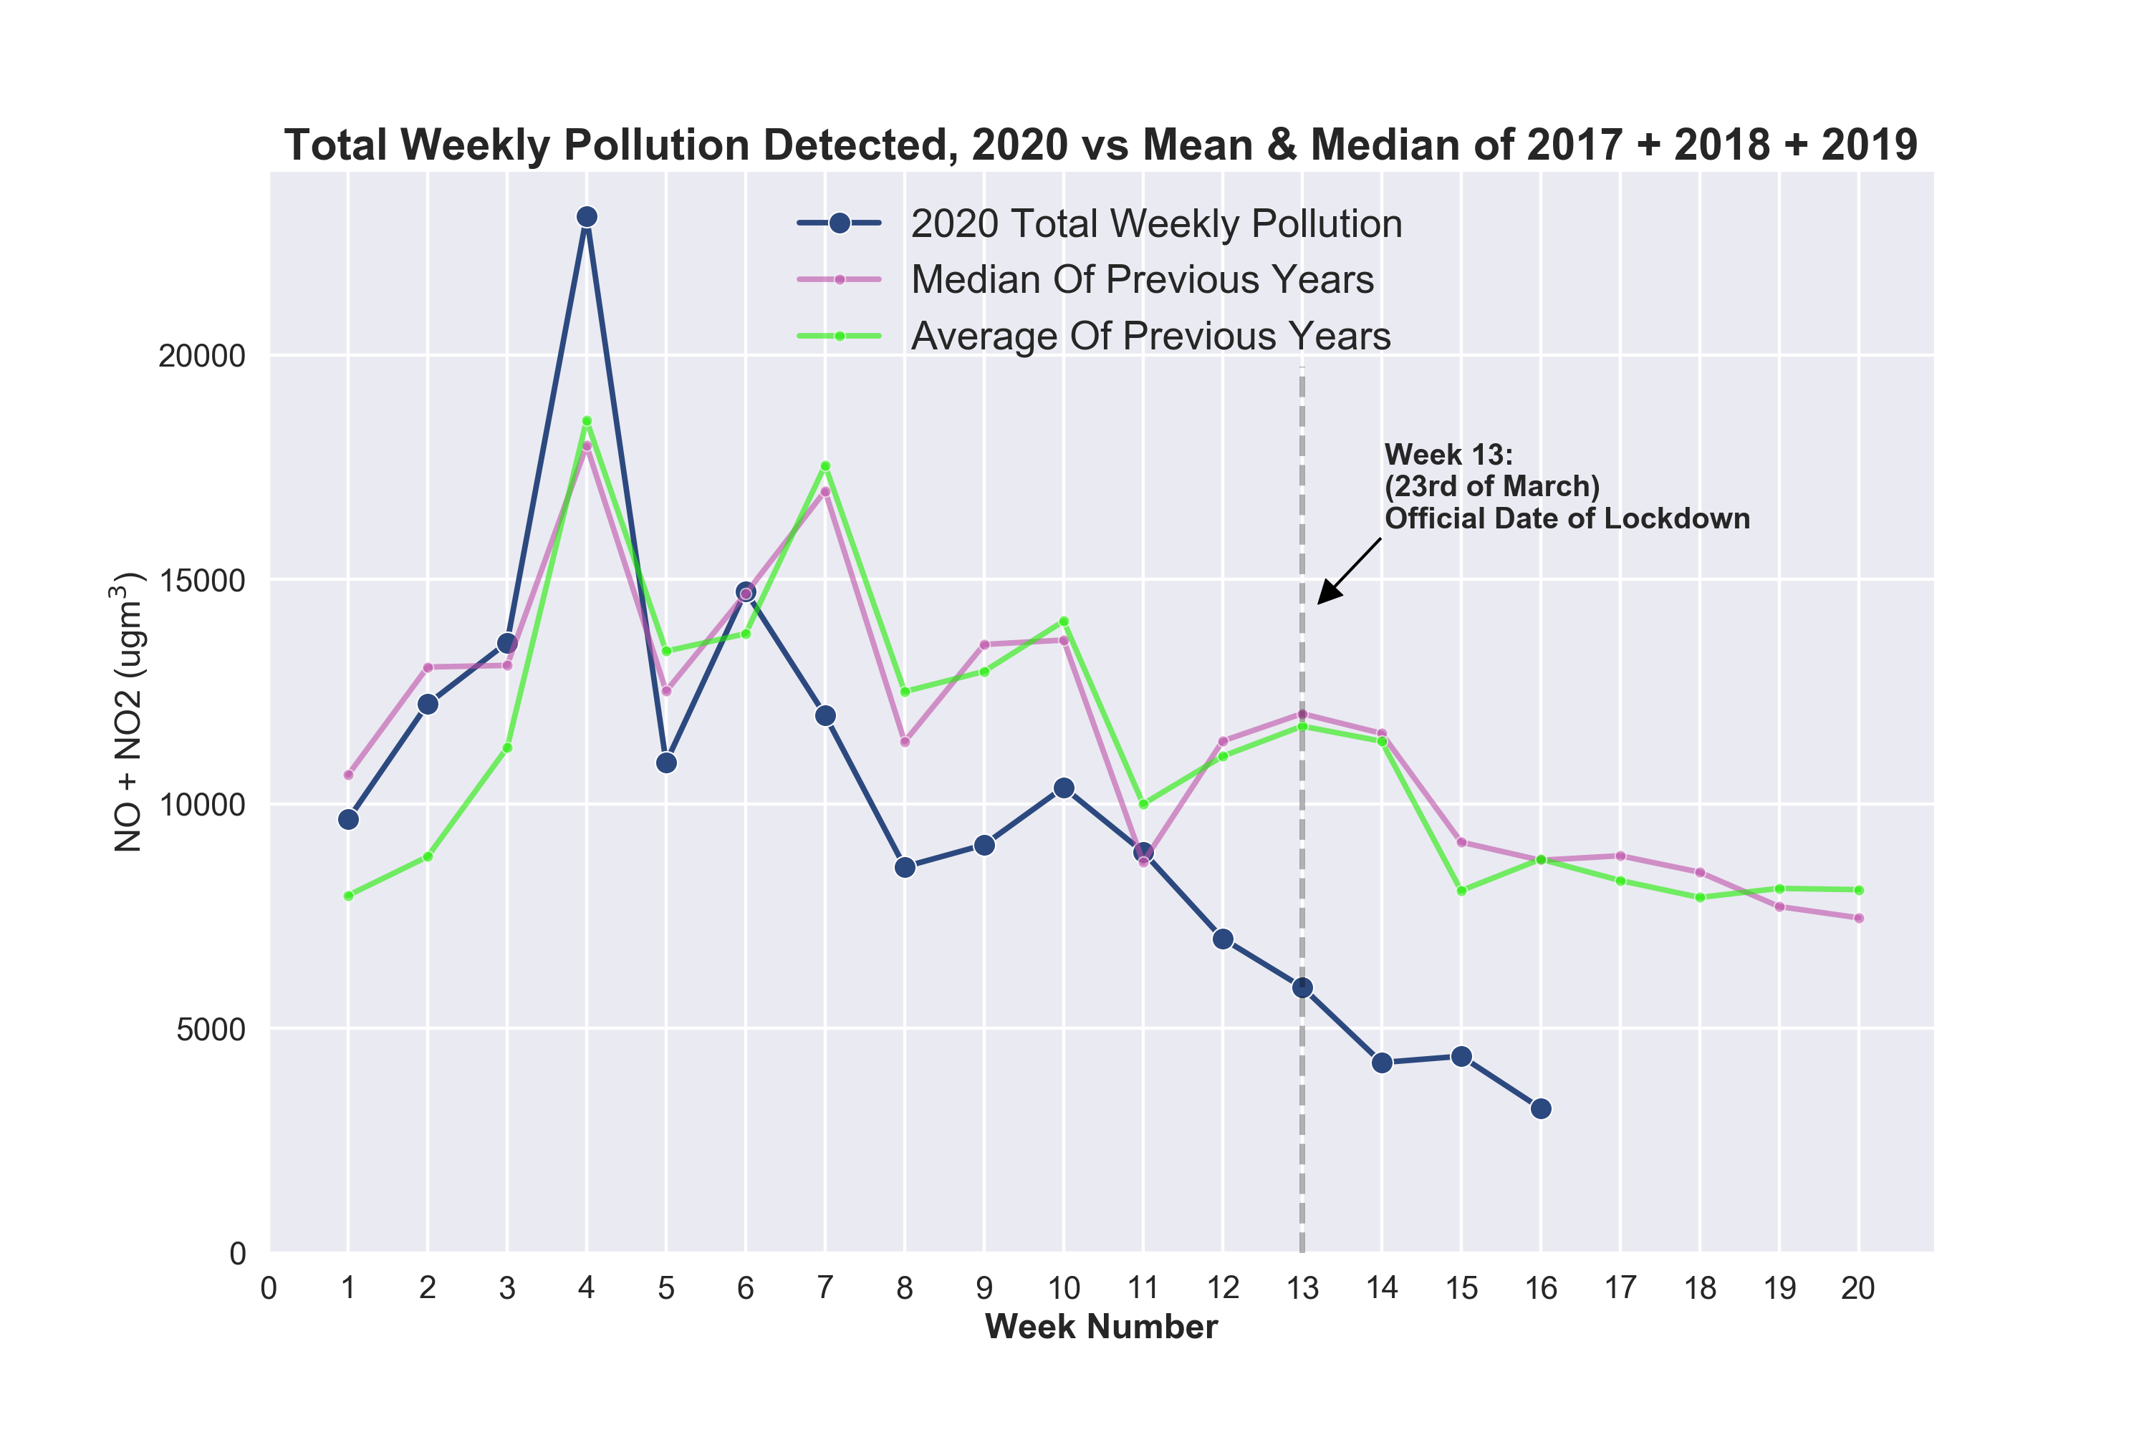
BETTER METHOD OF COMPARISON: Comparing 2020 to median and mean of 2017 + 2018 + 2019

Slide 18
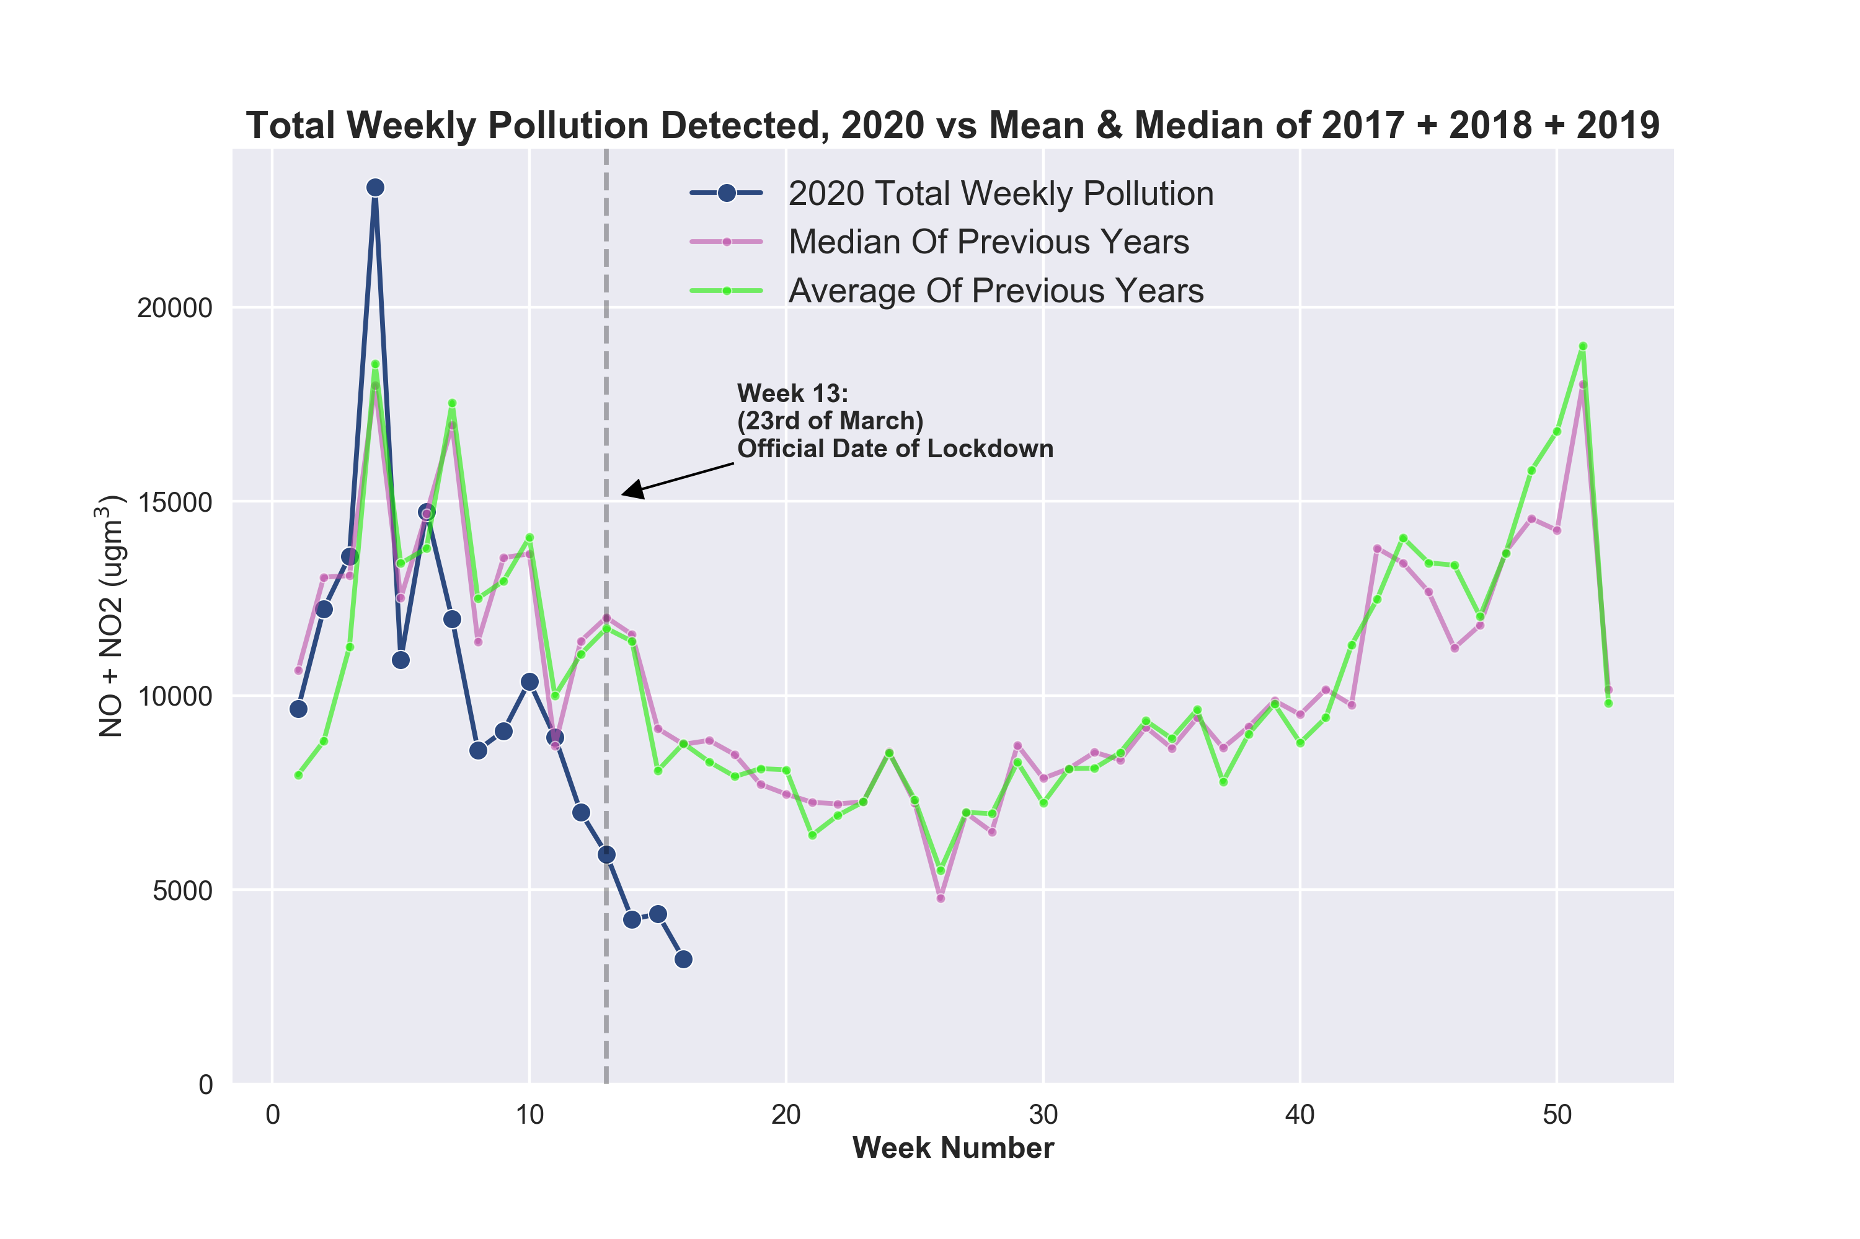

Slide 19
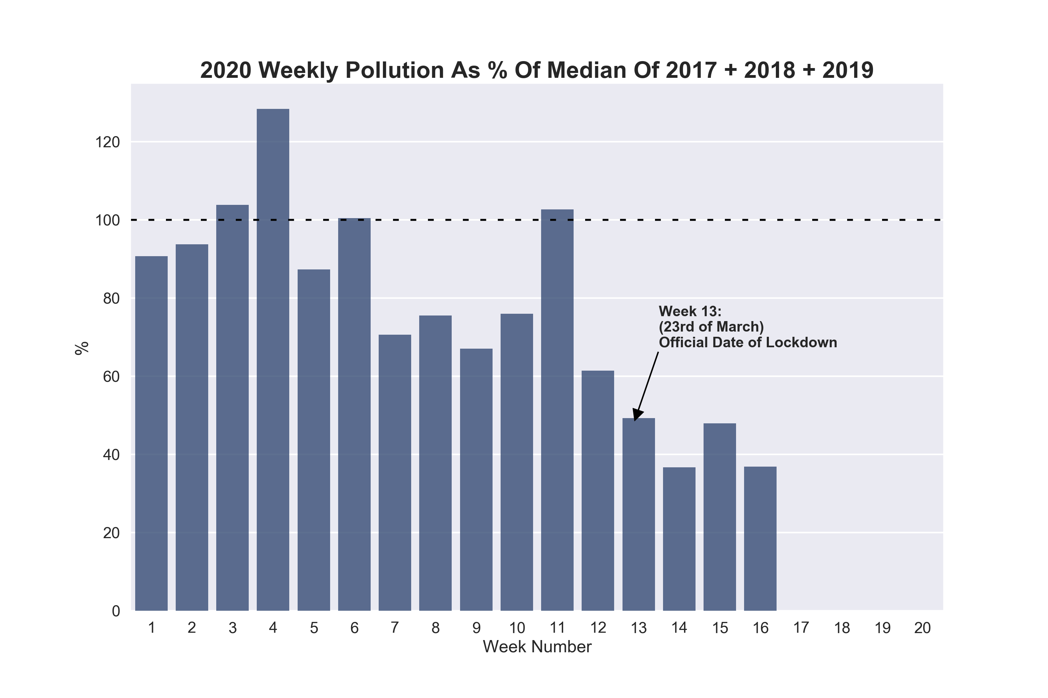
Similar to previous: asking “how is 2020 comparing to “normal” pollution levels measured in previous years?
Most weeks show pollution less than median (dashed line)

Slide 20
2020 monthly pollution vs previous years

Slide 21
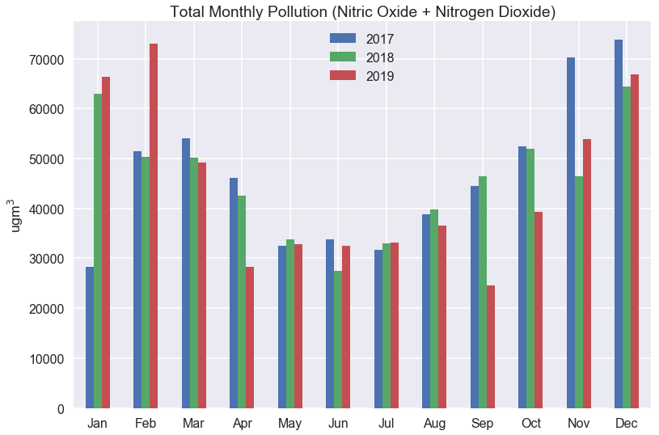
How each full month of 2020 compares to previous 3 years
Note Q1 and Q4 have high pollution, and pollution drops in Q2 and Q3

Slide 22
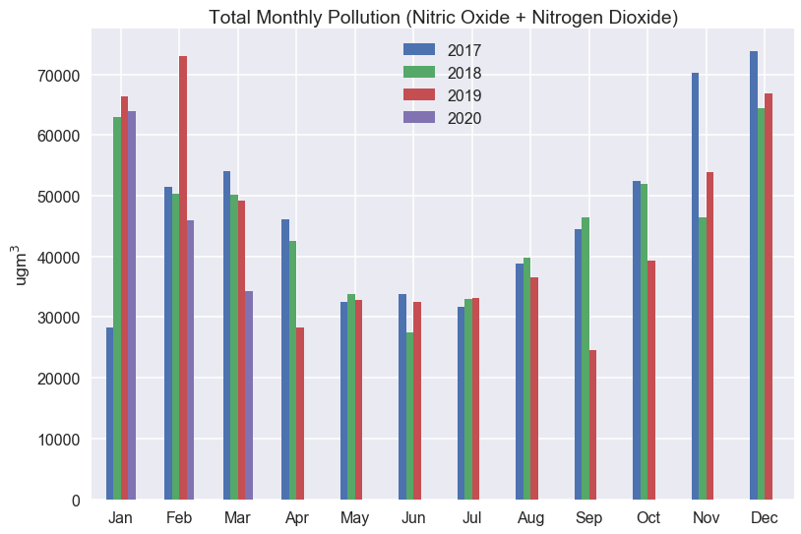
How each full month of 2020 compares to previous 3 years
Note Q1 and Q4 have high pollution, and pollution drops in Q2 and Q3

Slide 23
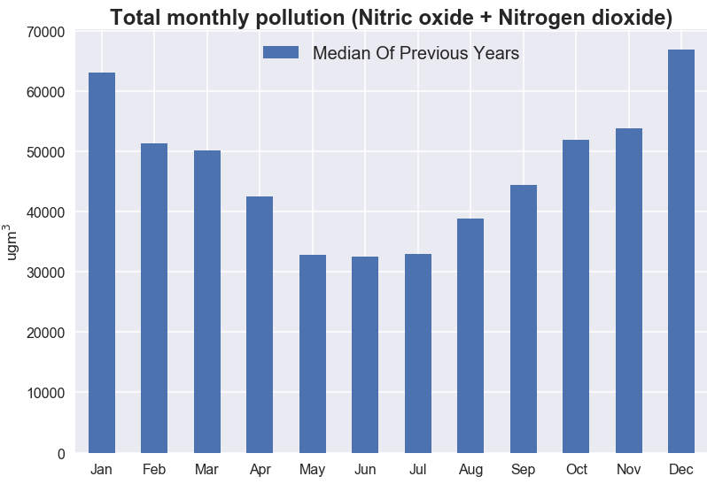

Slide 24
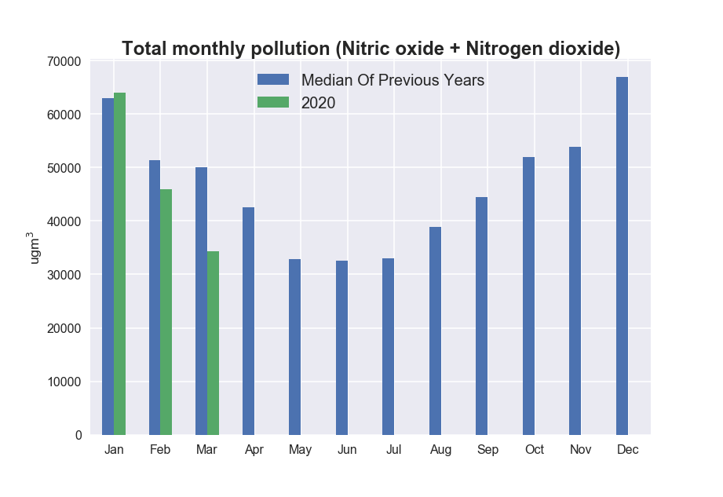

Slide 25
2020 hourly pollution since official lockdown

Slide 26
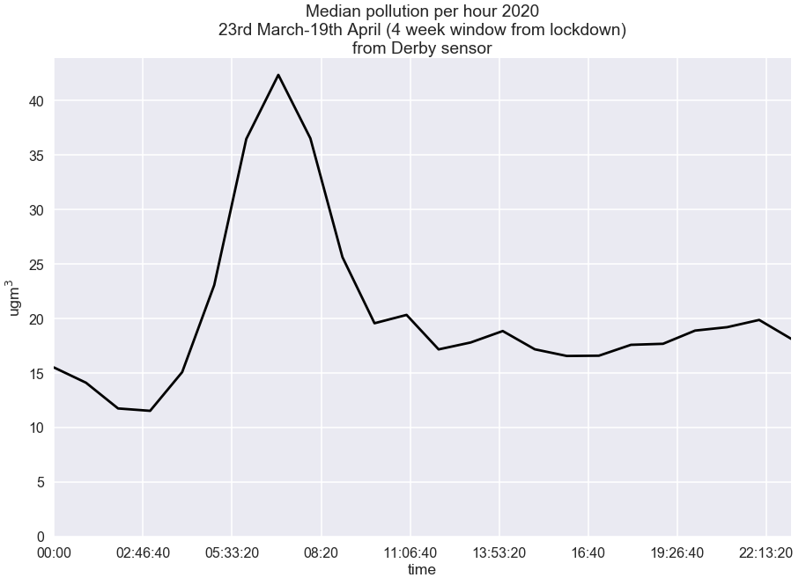

Slide 27
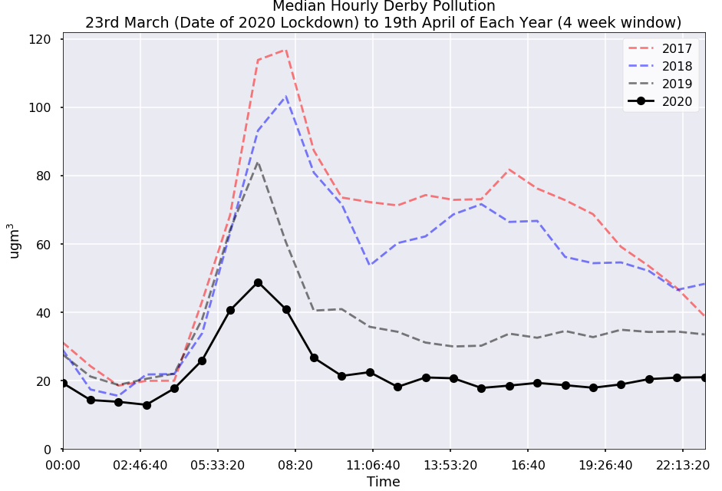

Slide 28
Final one: 2020 pollution vs Apple Mobility data
Notes:
Fun one

Slide 29
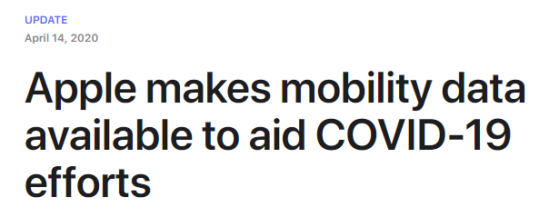
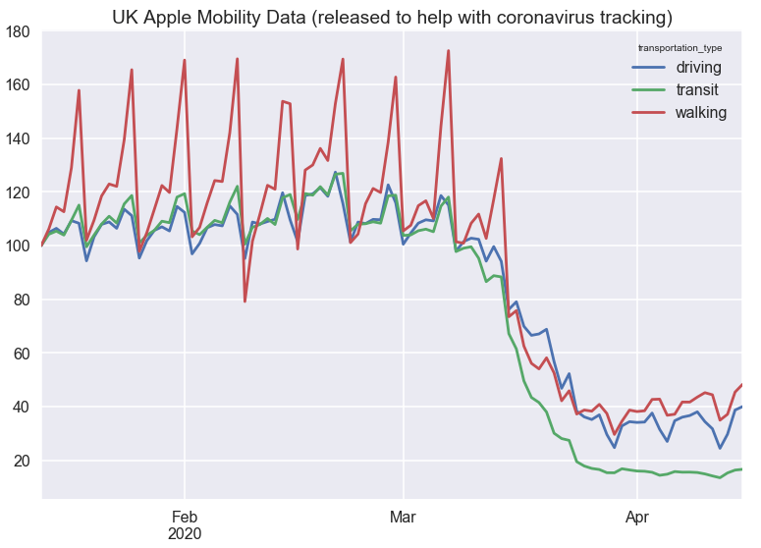

Slide 30
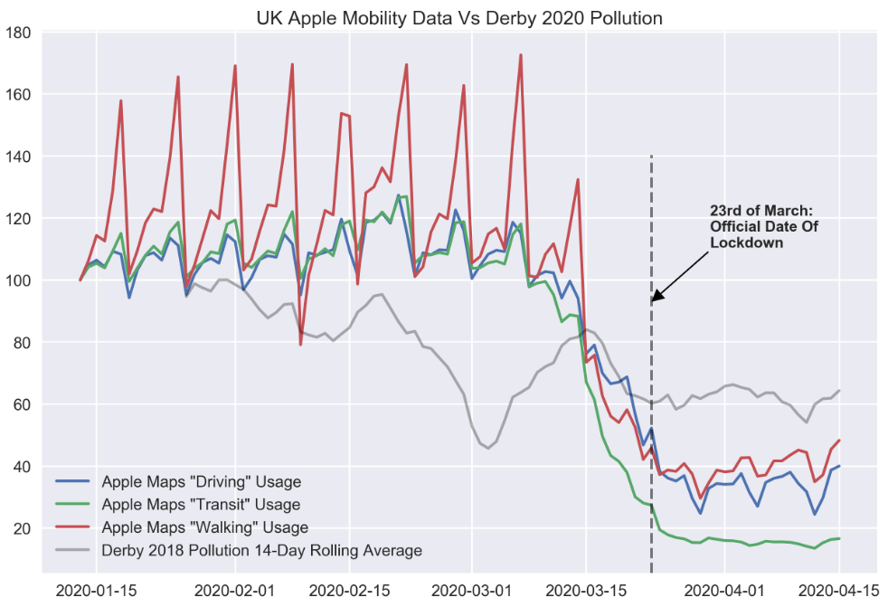

Slide 31
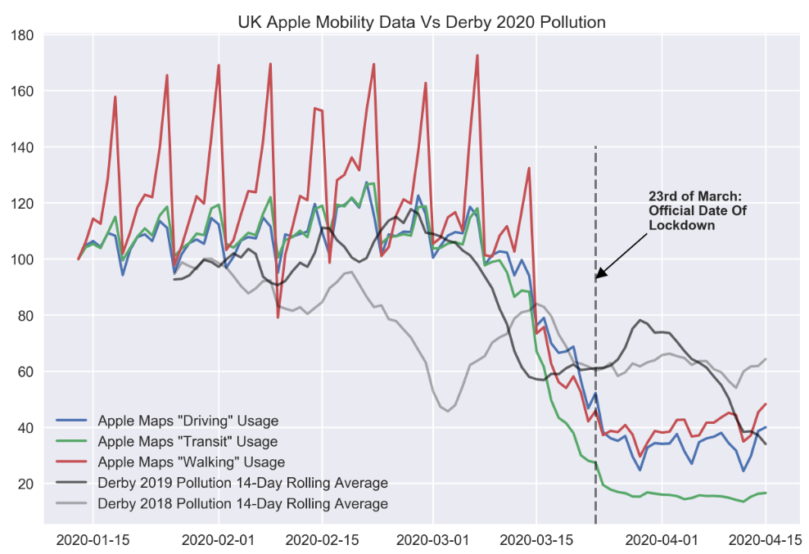

Slide 32
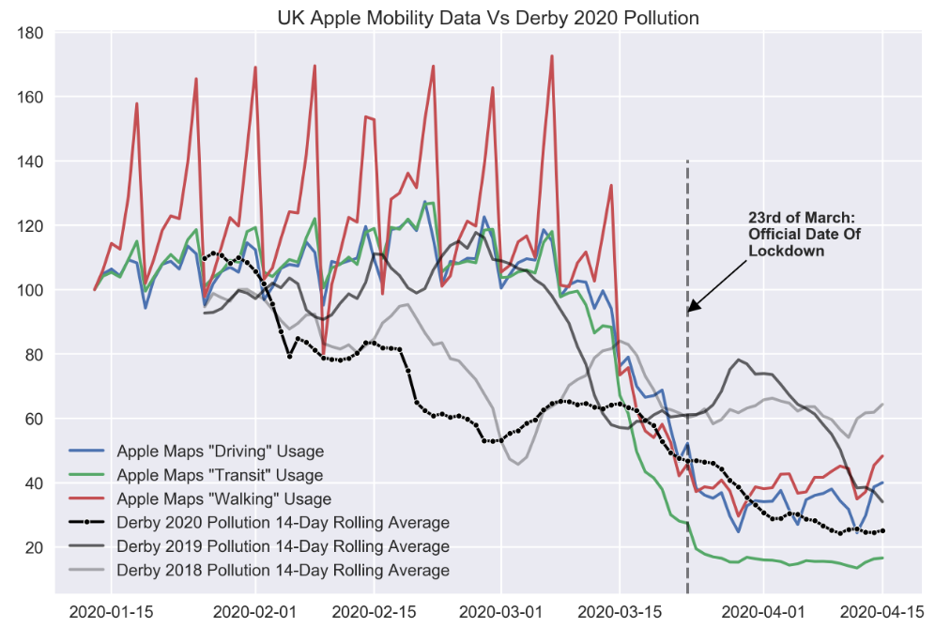

Slide 33
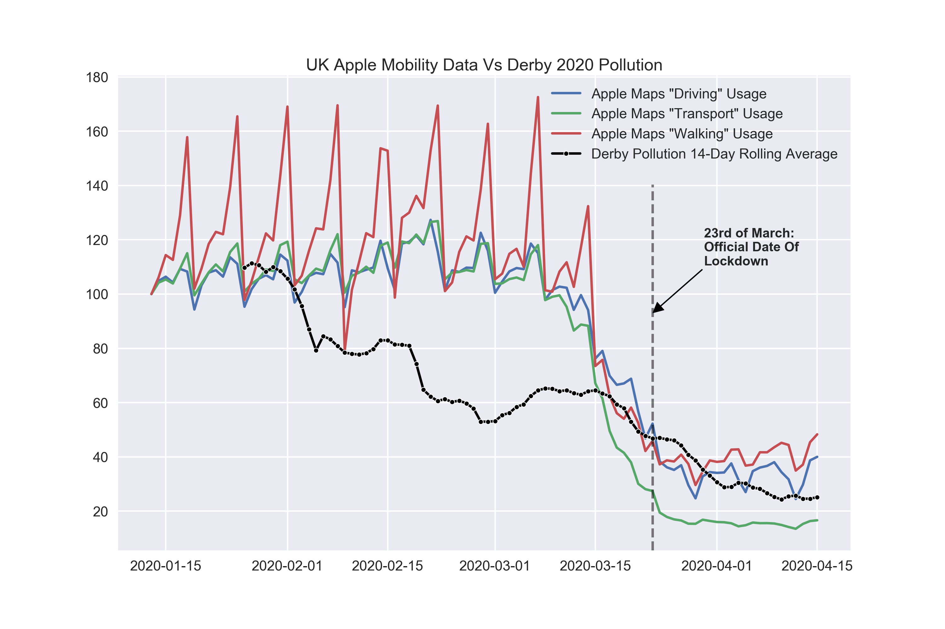
Daily Derby air pollution measured vs Apple Mobility data
Notes:
Derby air pollution dropped before official lockdown date and before Apple data (which is for whole of UK rather than specifically Derby) noted a change
Interesting plot but shows current limits of my knowledge – pollution was going to drop from Q1 to Q2 anyway, need to separate this out

Slide 34
What’s next?

Slide 35
What’s next
Continuing weekly & monthly analysis, sharing to Instagram
Further analysis, new questions & insights
Please feel free to get in touch if you have any ideas or questions!
Adding weather data to allow machine learning – predict future pollution
Website?

